Slide 1
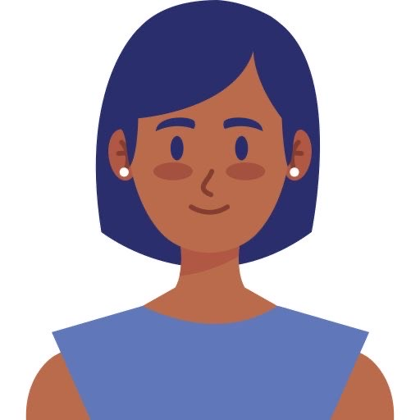
“I am a teacher who has lovely students, I love them with whole my heart and always try to give them the best experience”
Goals
Encourage my students to do their best
Try to do my job in different and positive way
Try to make a friendly atmosphere in my classes
Frustrations
I have to order the flowers daily in advance
I have limited budget so I prefer to order flowers with reasonable price
I would appreciate some discount on my daily purchase
Sarah
Age:
Education:
Hometown:
Family:
Occupation:
40
Master degree education
Paris, France
Married with one child
Teacher
Sarah is a teacher. She is passionate about her job, her workplace and also her students. Sarah always tries to make her class atmosphere fresh and inspiring by different ways to encourage her students and energize them, for example every session she gives some flowers as a gift to active students. But she has to manage this activity with limited budget.

